Slide 1
Digital Identity Working Group
16 March 2018

Slide 2
WofG Digital Identity Program Components
Australian Business Register
Document Verification Service (DVS)
Identity Proofing Providers (IdPs)
RAM
ATO Services (e.g. Online Services, ATO App, TFN Application)
AUSid IdP
Facial Verification Service (FVS)
Other Government IdP ?
Other Commonwealth Agencies
The “Exchange”
Australia Post IdP
State Agencies
Australian
Passport
Drivers Licence
Private IdP
Other Government Agencies
VISA
Other WofG services (e.g. myGov Portal, Inbox, TUO)
Private Sector (e.g. Digital Service Providers, Banks)
FOR OFFICIAL USE ONLY –Digital Identity Working Group
2

Slide 3
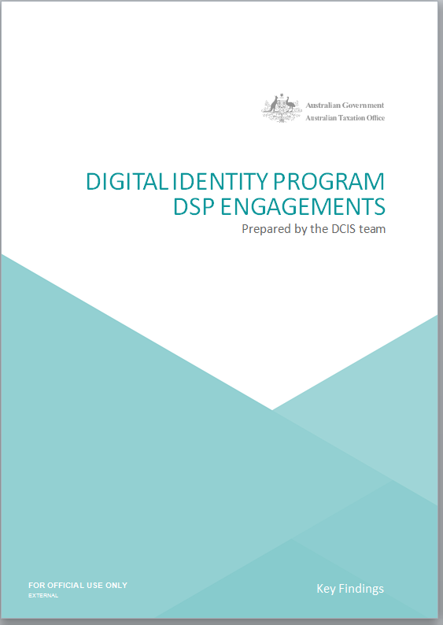
2017 Industry Engagement
WHEN WE CONSULTED
Between the months of May to July 2017 a process was run to test our initial designs with developers
WHO WE ENGAGED
A closed group of Digital Service Providers (DSP) was formed to partake in the design discussions. The group consisted of eight DSP representatives in total.
WHAT WAS TESTED
4 industry scenarios were considered and tested against the identity solution. Ranging from purchasing software, new employee records, access and machine to machine transactions (AUSkey alternative).
HOW WE PERFORMED
The engagement was conducted one on one with each developer, to draw out insights into their own build environment. Feedback across the design was measured and recorded.
A comprehensive report was developed highlighting the findings drawn from this event, and is available to the new working group
FOR OFFICIAL USE ONLY –Digital Identity Working Group
3

Slide 4
OVERVIEW|PAYLOAD ENCRYPTION AND SUPPLY CHAIN VISIBILITY
The Digital Service Provider (DSP) Operational Framework was developed as part of the ATO response in recognising and responding to risks posed by Application Programming Interface (API) based wholesale digital services. The DSP Operational Framework identified five key issues that equated to gaps in our understanding of the DSP operating environment.
While other issues were addressed by the development of requirements for DSPs consuming our services, it was recognised that new capabilities would need to be developed to address supply chain visibility and payload encryption.
Payload encryption
The purpose of payload encryption is to protect the confidentiality of information as it flows from an originating system to the ATO. The new capability will enable a Digital Service Provider (DSP) user to encrypt data for transmission to the ATO. The encrypted data may flow through one or more intermediaries, but can only be decrypted by intended recipient.
Supply chain visibility
The purpose of supply chain visibility is to provide a level of confidence in the integrity of data, which flows through a supply chain between the sender and the ultimate receiver. The new capability will provide visibility of each entity that is directly involved in a specific transaction received by the ATO. The ATO will be able to determine a DSPs role and order of participation in each transaction.
Certification and Assessment
Multi-factor Authentication
Onshore/offshore Hosting Arrangements
Supply Chain Visibility
Payload Encryption
4

