Slide 1
Individual Income Tax
Real-time messaging
Presented by
Ross Barns – Director, Digital Projects
Individual Engagement and Support (IND)
27 October 2017
Australian Taxation Office

Slide 2





Real-time messaging: a foundation for the future
Over the past couple of months a Micro Group of the ABSIA & ATO PLS Transition Roundtable forum has been considering a number of proposals to deliver client-focused risk information and greater levels of transparency with tax agents
1
2
Prior-year messaging across all channels
Tax Time 2018
Real-time messaging for PLS
Tax Time 2018
Tax professionals
Software developers
ATO
Community
3
Provision of lower level information via PLS
Tax Time 2019

Slide 3
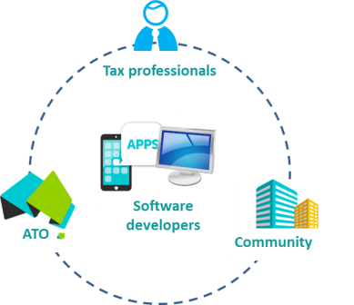

Prior-year messaging across all channels – TT2018
1
TT2017 – WRE risk message included in pre-fill via the Tax Agent Portal report
TT2018 – Expanded to PLS and myTax
    Pre-fill indicator and message text passed to PLS
Work-related expenses
Your client’s total work-related expenses for 2016–17 were high compared to those in the same occupation with similar income. We recognise that larger claims can be legitimate, however we may review deductions if they remain high in 2017–18. In preparing this year’s return please ensure:
your client spent the money and was not reimbursed
it is directly related to earning their income
they have a record to prove it.

Slide 4
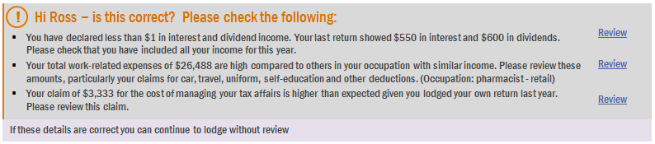
Real-time risk messaging for PLS – TT2018
2
MyTax solution – since TT2016
    Work-related expenses
    Cost of managing tax affairs
    Interest and Dividend income (introduced TT2017)
TT2018 – Expansion into PLS
Design considerations
    Create visibility of our risk assessment
    Focus for TT2018 would be limited to work-related expenses
    Ability to call all or specific risk models at the tax agent’s discretion via a web-based service

Slide 5

Real-time risk messaging for PLS – TT2018
TT2018 – Expanded to PLS
    Key input variables
2
Label description | Label ID | Item ID
Tax file number | Your tax file number (TFN)
Tax agent reference number | Agent’s reference number
Individual occupation code | 1 Salary or wages – occupation code
Salary and wages amount (sum of all values) | 1 Salary or wages | C – G (aggregated)
Allowances, earnings, tips, director’s fees income amount | 2 Allowances, earnings, tips, director’s fees etc. | K
Reportable fringe benefits total amount | IT1 Total reportable fringe benefits amounts | N & W (aggregated)
Work-related car expenses amount | D1 Work-related car expenses | A
Work-related travel expenses amount | D2 Work-related travel expenses | B
Work-related clothing expenses amount | D3 Work-related uniform, occupation specific or protective clothing, laundry and dry cleaning expenses | C
Work-related self-education expenses amount | D4 Work-related self-education expenses | D
Work-related other expenses amount | D5 Other work-related expenses | E
If the service were available for July 2018, would you:
use it immediately, or
implement during 2018 lodgment cycle?
How would you implement?

Slide 6
Provision of lower level information via PLS – TT2019
3
Opportunities
  streamline interactions with the ATO through reduced or more tailored enquiries
  provide a consistent digital channel for self-preparers and agent returns, facilitating the easy transfer of client information
  provide access to historical return information
  Consultation program through 2017–18 with tax agents, professional associations, digital service providers and Government

