Slide 1
DSP Briefing Sessions
August 2017
DRAFT
Additional SBR2 Gateway in AWS Cloud
Not to be reproduced without permission

Slide 2
Contents
System improvements implemented to date 3
Improving SBR2 4
Re-architecture for improved resilience 5
Additional SBR2 Gateway in AWS 6
Connections (On-premises and AWS) 7
Onboarding timeline: SBR2 to AWS Cloud 8
Onboarding Planning Activities 9
Security 10
Support, Monitoring & Reporting 11
SBR2 – Further Detail 12
Questions 13
UNCLASSIFIED – DSP Briefing Sessions August 2017 – SBR2 in AWS

Slide 3
Improvements implemented to date | Summary
 | Improvements
 | Migrated to the new SAN architecture with full data replication Moved two key applications to cloud operations (ato.gov.au and ATO Online)
 | Enhancements to the operations monitoring centre to bolster proactive monitoring capability of our systems Centralised log monitoring processes to manage the myriad of system logs to improve operational performance
 | Refined playbooks to enhance speed of recovery Codified manual activities Improvements to the IT incident management process and interface with ATO Business Continuity Management
 | Replicated many previous ‘single point of failure’ systems into a second data centre
Infrastructure investment
Performance and operational improvements
Process, tools and governance
Architect for resilience
UNCLASSIFIED – DSP Briefing Sessions August 2017 – SBR2 in AWS
3

Slide 4
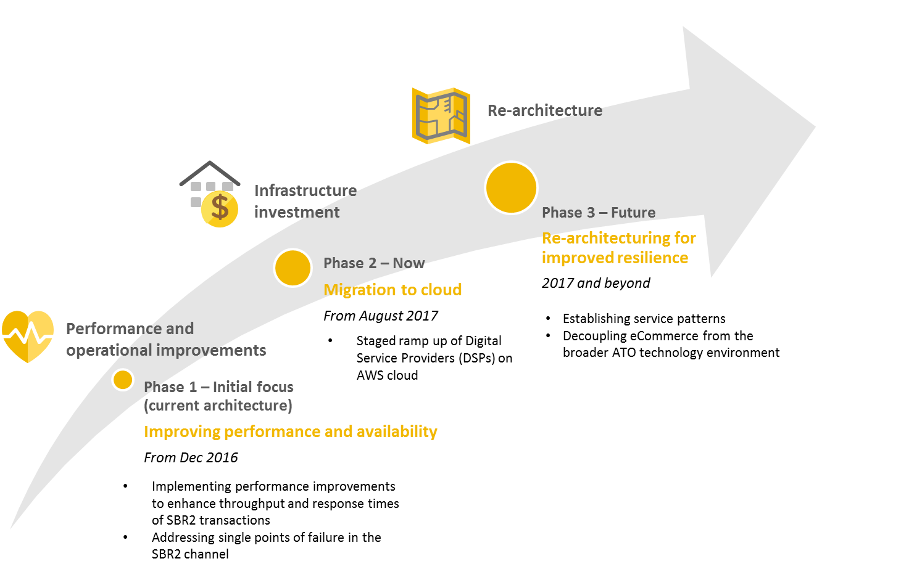
Improving SBR2
UNCLASSIFIED – DSP Briefing Sessions August 2017 – SBR2 in AWS

Slide 5
Re-architecture | Re-architecting for improved resilience
Decoupling back-end systems to improve resilience
Implementation of designs to support limited service patterns
Investigation of an approach for single interactive patterns.
Note: This slide represents early thinking. The future architecture patterns are still being explored.
Queued Batch
Users are able to submit batch and bulk transactions which will be validated, queued and a submission receipt is returned.
Limited Service Mode
Single interactive transactions will be validated and stored until back-end systems are available. A submission receipt is returned. Users are able to complete obligations but need to return for response when systems are available.
Access Response
Users are able to access processed responses on the channel even if back-end systems are unavailable.
Access Key Reports
Users are able to access key reports and informational services available on the channel.
Access Offline Data
Users are able to access key personal and identification information and pre-fill data from a secondary data source. Users are advised of the currency of data as limitation on service.
UNCLASSIFIED – DSP Briefing Sessions August 2017 – SBR2 in AWS

Slide 6
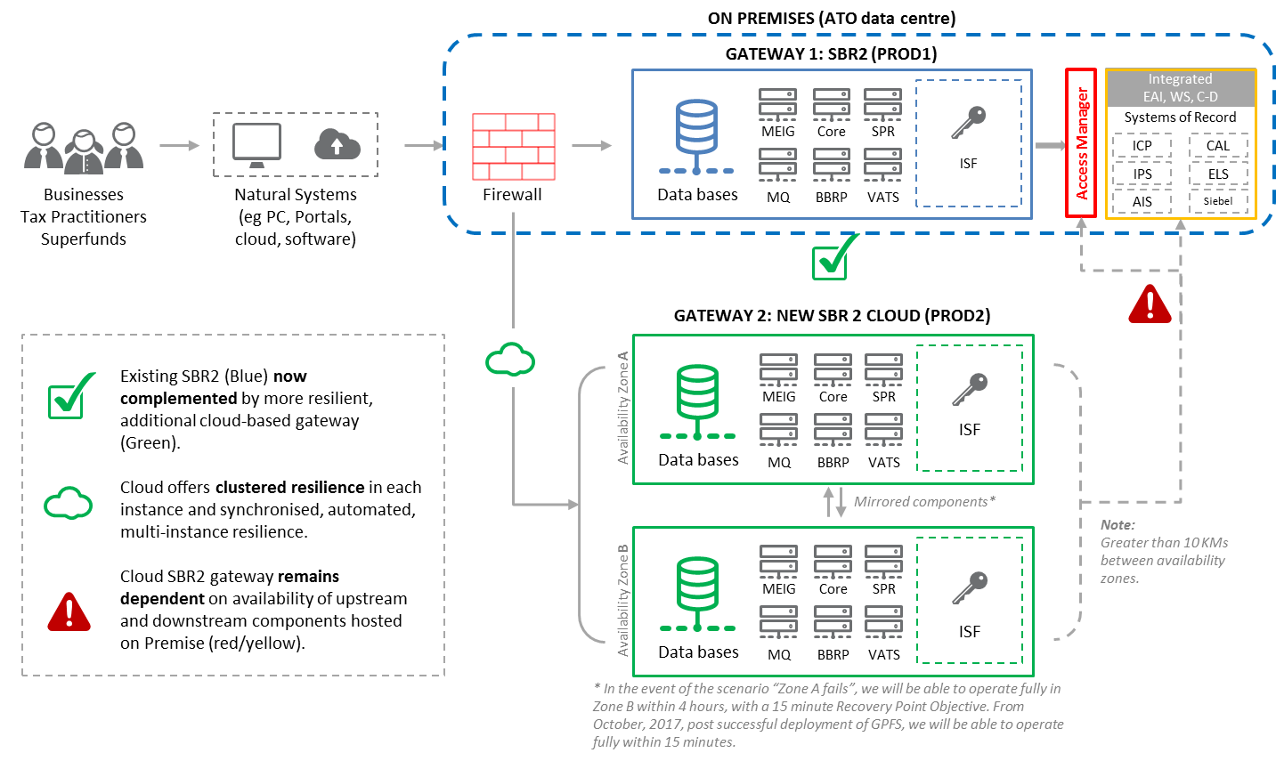
Additional SBR2 Gateway in AWS – Enhanced Resilience
UNCLASSIFIED – DSP Briefing Sessions August 2017 – SBR2 in AWS

Slide 7
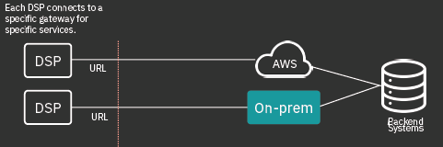
SBR2 – Connections (On-prem and AWS)
Patterns for connecting to SBR2
Access to AWS eCommerce Cloud or eCommerce on-premises is fundamentally activated by a change in the DSP application to send to one of the two URLs. The pointing of the DSP application can be to either URL, provided their product remains whitelisted in both AWS and the on-premises solution (which it will be at this juncture).
When changing between environments, there is a need to ensure that there are no bulk/batch submissions still in flight.
In the current solution, the backend business response to asynchronous bulk/batch submissions will be returned to the MEIG Payload Store through which the original transactions flowed.
A move to the alternate URL before the response message is pulled will result in no response found at the new URL.
Connection during Staged Implementation
UNCLASSIFIED – DSP Briefing Sessions August 2017 – SBR2 in AWS

Slide 8
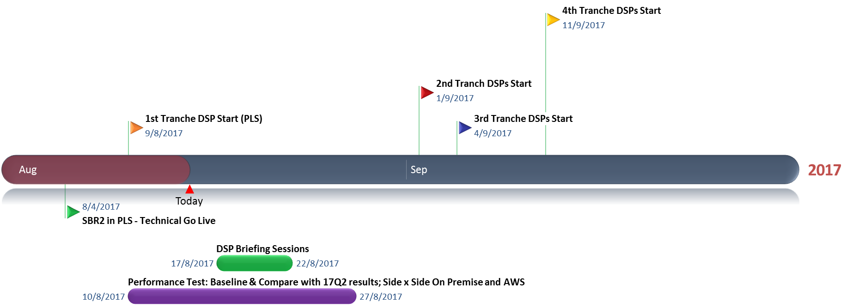
Onboarding Timeline: SBR2 to AWS Cloud
Notes
UNCLASSIFIED – DSP Briefing Sessions August 2017 – SBR2 in AWS

Slide 9
SBR2 in AWS – Onboarding Planning Activities
What information is expected from PLS ‘early adopters’?
Type of software implementation (i.e. desktop or cloud)
Participation of a ‘friendly’ tax agent
Details on the API types to be used (e.g. IITR 2017 and associated schedules – e.g. the rental schedule that the agent will be submitting)
Timeframes for implementation (considering internal lead-times to make endpoint configuration changes)
To support quality assurance we may seek (post transaction):
  details of request and response payloads, message IDs, and a copy of the return.
What information is expected from Super and STP ‘early adopters’?
Service to be utilised (e.g. SMAT2)
Super: agreed trustee participation
Timeframes for implementation
What support will be made available to DSPs as they come onboard?
Your ATO Account Manager will work with you to plan your onboarding to the Cloud gateway.
UNCLASSIFIED – DSP Briefing Sessions August 2017 – SBR2 in AWS

Slide 10

SBR2 in AWS – Security & Risk Management
The AWS Cloud environment has been certified by the Australian Signals Directorate (ASD) as compliant, including requirements for all data to remain on shore and protected by suitable encryption protocols.
UNCLASSIFIED – DSP Briefing Sessions August 2017 – SBR2 in AWS

Slide 11
SBR2 in AWS – Support, Monitoring, & Reporting
The Cloud-based SBR2 gateway Support Services have been established to provide the same level of support as exists today for the On Premises gateway.
  The environments will be supported with equal priority
  Support will be engaged by the SBR Service Desk on 1300 488 231 or via SBRServiceDesk@sbr.gov.au (available between 8:00am and 7:00pm AEST Mon-Friday, excluding public holidays.
The ATO’s Cyber Security Operations Centre (CSOC) has established monitoring of all traffic through the gateway.
Systems Monitoring is established in PROD2 (AWS) as per PROD1 (On Premises).
Availability Reporting will be updated to include PROD2 (AWS) by mid Sept 2017.
UNCLASSIFIED – DSP Briefing Sessions August 2017 – SBR2 in AWS

Slide 12
SBR2 in AWS – Further detail
PROD2 will deployed into a virtual private cloud (VPC) hosted by Amazon Web Services in Sydney.
Superannuation, PLS & STP services are fully supported in PROD2.
Software developers may choose whether they wish to use PROD1 or PROD2 – in the future the ATO will direct DSPs to the optimal gateway.
PROD2 will have improved resilience as it will sit across physically separate zones in AWS.
End to end resilience limitations associated with SBR2 PROD1 ‘today’, will still exist in PROD2. For example, PROD2 is still dependent on On Premises services being available (Access Manager, ICP, etc).
PROD2 is connected to the ATO via a secure connection (SAGE).
PROD2 will operate in parallel with PROD1 (On Premise).
PROD1 and PROD2 have different endpoint domain names “ato.sbr.gov.au” and “prod2.ato.sbr.gov.au” respectfully.
There will be no hardware load balancing of traffic between PROD1 and PROD2 environments (at this time).
UNCLASSIFIED – DSP Briefing Sessions August 2017 – SBR2 in AWS

Slide 13
Questions?
For any follow up questions and or to commence planning for your utilisation of the new gateway, please contact your ATO Account Manager or email: sipo@ato.gov.au

